Slide 1
Machine Learning Spam Filter
Project Goal & Core Task:
Develop a robust machine learning model to classify emails as Spam (+1) or Not Spam (-1)
Primary objective: Maintain an extremely low False Positive Rate (FPR)
Critical focus: Maximize the Spam Detection Rate (TPR)

Slide 2
Key Requirements & Constraints
Strict FPR Limit: The model must not exceed a False Positive Rate of 0.2%
High Priority: Incorrectly classifying a legitimate email (a false positive) is considered a critical error
Objective: Find a balance between aggressively blocking spam and ensuring no important emails are lost

Slide 3
The Dataset: A Bag-of-Words Approach
Format: MATLAB file containing a sparse matrix X and a label vector y
Dimensions (after processing):
X: 10,000 samples (emails) × 57,173 features (unique words)
y: 10,000 labels (+1 for Spam, -1 for Not Spam)
Explicit Example:
A sparse data entry like (520, 3) -> 4 from the original file translates to: "For Email #3, the feature for word #520 from the vocabulary has a value of 4."

Slide 4
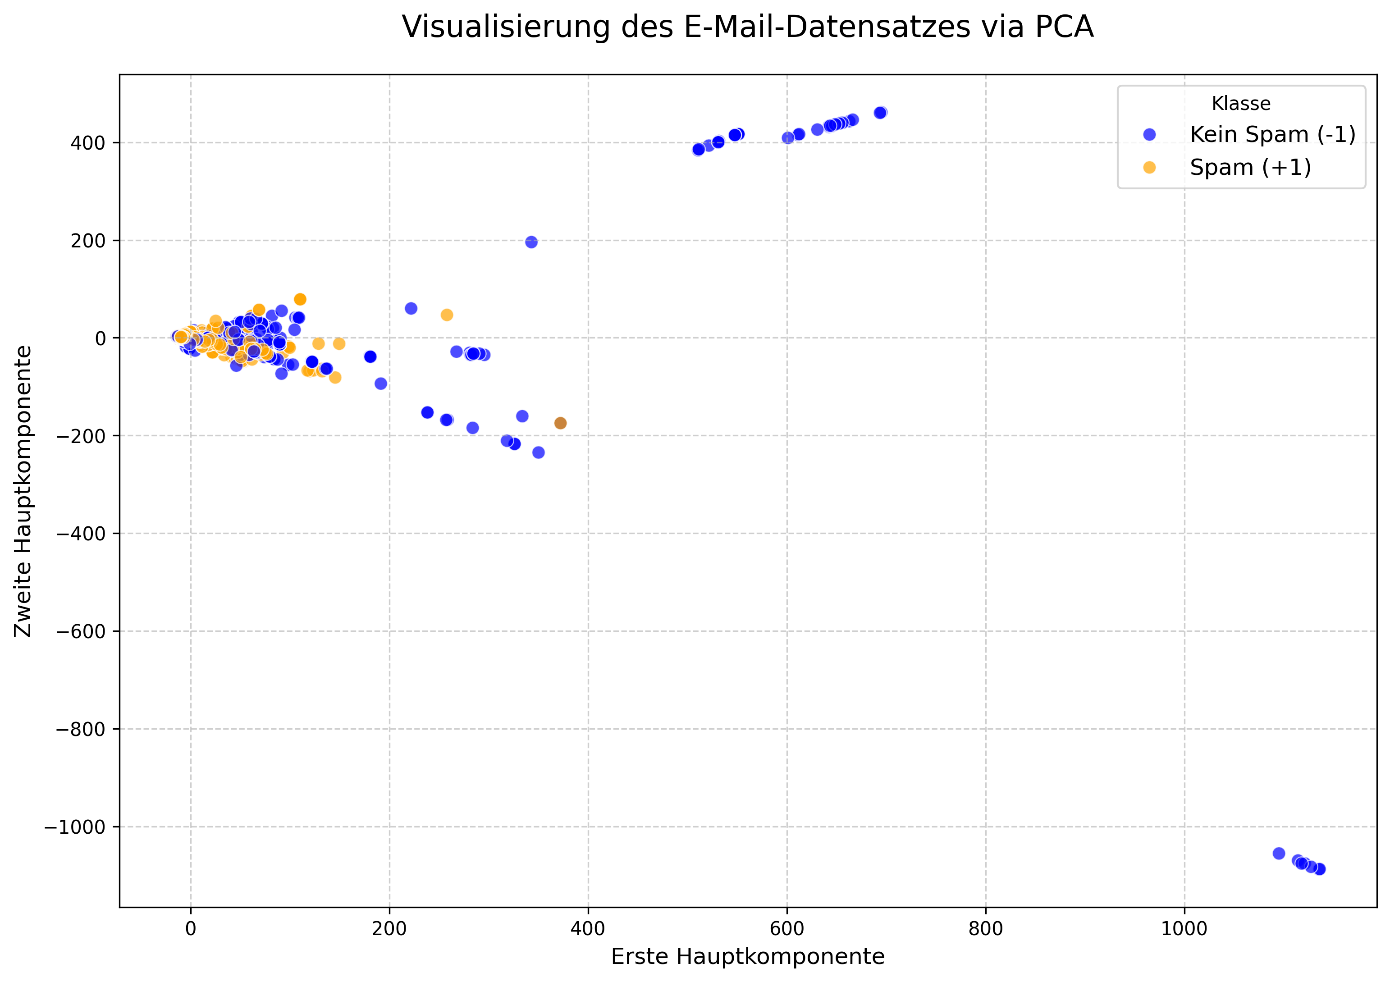

Slide 5
Why SVM & Random Forest?
Support Vector Machine (SVM - Linear Kernel):
Excellent performance in high-dimensional spaces (like text data)
Creates a maximum-margin boundary, leading to strong generalization
Highly interpretable: easy to identify which words influence the classification
Random Forest (RF):
Powerful ensemble method, robust against overfitting
Handles non-linear relationships in the data implicitly
Requires minimal data preprocessing and is less sensitive to outliers

Slide 6
Program Architecture & Workflow
1. Data Loading & Preparation:
Load .mat file, transpose the matrix, and perform a stratified 80/20 train-test split
2. Threshold Optimization:
Use 5-fold cross-validation on the training set to find the optimal classification threshold
3. Final Training:
Train the final models on the entire 80% training set
4. Evaluation:
Measure the final performance (FPR, TPR) on the untouched 20% test set

Slide 7
Key Technique: Threshold Optimization
A standard 0.5 threshold is insufficient for the strict FPR requirement
5-fold cross-validation is used to find a threshold that maximizes TPR while staying below the 0.2% FPR limit
The maximum threshold from the 5 folds is chosen for a conservative and robust final model
This process ensures the threshold is optimized without data leakage from the test set

Slide 8
Final Evaluation
Models are trained on the full development set (X_dev)
Performance is measured on the hold-out test set (X_test), which the model has never seen
Key metrics: Resulting FPR and Spam Detection Rate (TPR)
Results are visualized using confusion matrices

Slide 9
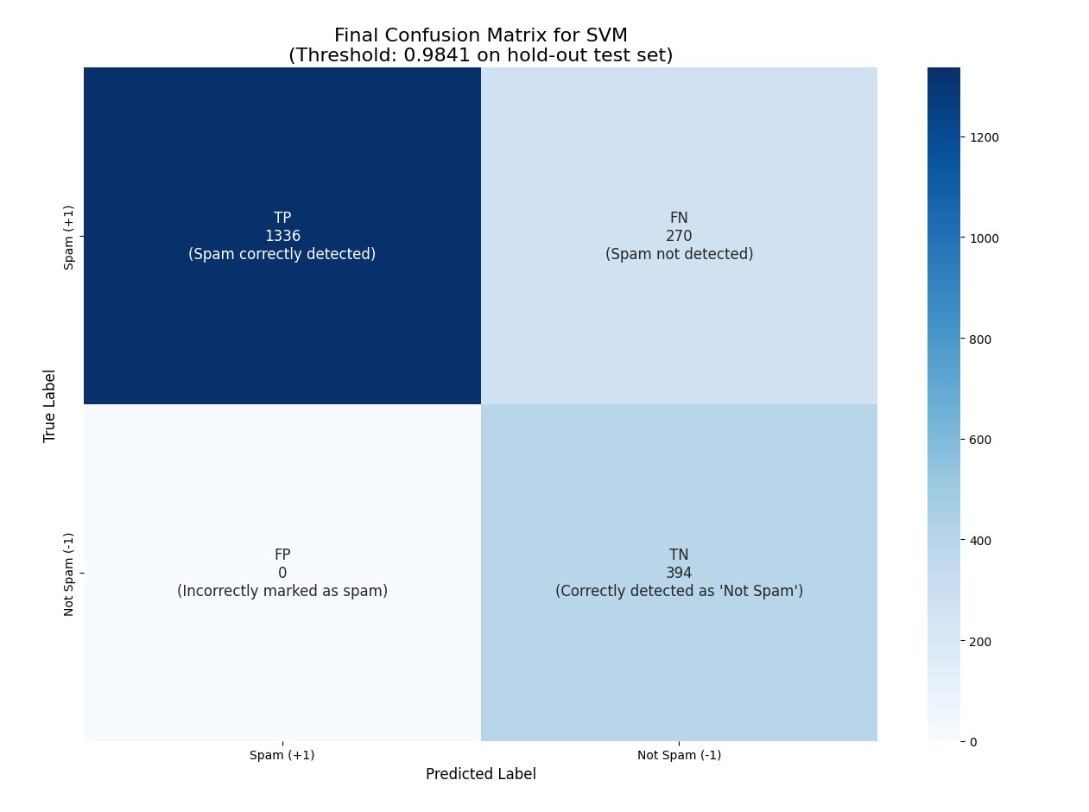

Slide 10
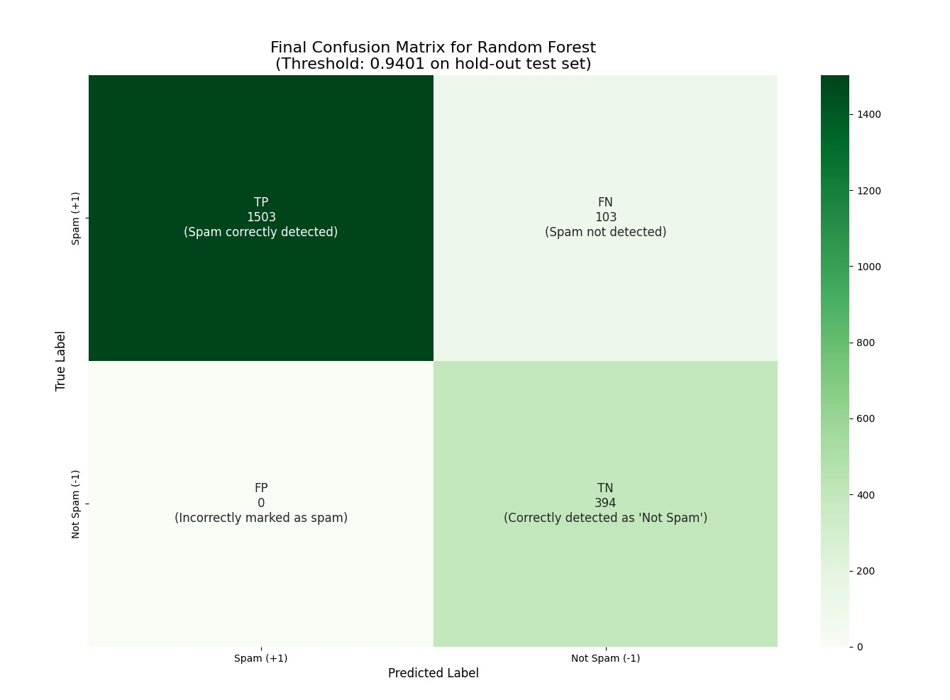

Slide 11
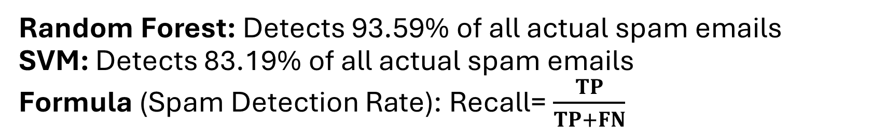
Performance on Hold-Out Test Set
Random Forest: Detects 93.59% of all actual spam emails
SVM: Detects 83.19% of all actual spam emails
Formula (Spam Detection Rate): Recall= $\frac{TP}{TP+FN}$
-> Recommendation: Random Forest
Highest Spam Detection (93.59%)
Zero False Positives (0.00% FPR)
Optimal balance of performance & security

Slide 12
